Slide 1

Secure Multiparty Regression Based on Homomorphic Encryption
Rob Hall
Joint work with Yuval Nardi (Technion) and Steve Fienberg
http://www.cs.cmu.edu/~rjhall
rjhall+@cs.cmu.edu

Slide 2
Structure
Setting and motivation.
Basic tools of cryptography.
Prior work
Techniques for regression.
Logistic regression
“Well known”
Our contribution

Slide 3


Setting
Multiple parties with private data:
e.g., is this vaccine causing hepatitis?
Long term vaccine safety surveillance (c.f., the FDA’s “sentinel initiative”)
Patient ID | Vaccine
0001 | Y
0002 | N
0003 | N
… | …
Patient ID | Hepatitis
0001 | N
0002 | Y
0003 | N
… | …
Health insurance agency
Hospital

Slide 4
Secure Multiparty Regression
Each party has a private (partial) data matrix
Patient ID | Vaccine | Age | Weight | Hepatitis
0001 | ? | 36 | 170 | N
0002 | ? | 26 | 150 | Y
0003 | ? | 45 | 165 | N
… | … | … | … | …
Party 1
Additional variables may be present
Patient ID | Vaccine | Age | Weight | Hepatitis
0001 | Y | 36 | ? | ?
0002 | N | 26 | ? | ?
0003 | N | 45 | ? | ?
… | … | … | … | …
Party 2

Slide 5

Secure Multiparty Regression
Patient ID | Vaccine | Age | Weight | Hepatitis
0001 | ? | 36 | 170 | N
0002 | ? | 26 | 150 | Y
0003 | ? | 45 | 165 | N
… | … | … | … | …
“Full data”
Assumptions: Complete and properly joined
Patient ID | Vaccine | Age | Weight | Hepatitis
0001 | Y | 36 | 170 | N
0002 | N | 26 | 150 | Y
0003 | N | 45 | 165 | N
… | … | … | … | …
Patient ID | Vaccine | Age | Weight | Hepatitis
0001 | Y | 36 | ? | ?
0002 | N | 26 | ? | ?
0003 | N | 45 | ? | ?
… | … | … | … | …
Goal is regression on full data

Slide 6
Secure Multiparty Regression
Patient ID | Vaccine | Age | Weight | Hepatitis
0001 | ? | 36 | 170 | N
0002 | ? | 26 | 150 | Y
0003 | ? | 45 | 165 | N
… | … | … | … | …
Data are “private”
Patient ID | Vaccine | Age | Weight | Hepatitis
0001 | Y | 36 | 170 | N
0002 | N | 26 | 150 | Y
0003 | N | 45 | 165 | N
… | … | … | … | …
e.g., HIPAA
Patient ID | Vaccine | Age | Weight | Hepatitis
0001 | Y | 36 | ? | ?
0002 | N | 26 | ? | ?
0003 | N | 45 | ? | ?
… | … | … | … | …

Slide 7

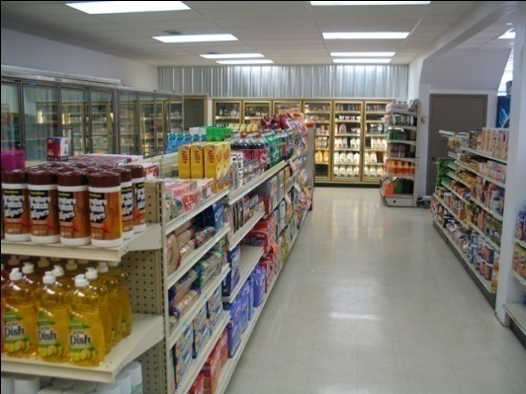

Alternate Settings
Fictional scenario based on discussion with CyLab corporate partners:
Store
TV Network
Records of transactions
Records of commercial views
Regression of advertising effect

Slide 8
Two Types of Privacy Breach
Information leakage via the computation itself:
Focus of this talk.
Dealt with via “cryptographic protocols.”
Information leakage via the output:
Not in this talk.
Assume the parties have deemed that the regression is “safe” to compute.
Otherwise may use e.g., “Differential Privacy.”

Slide 9

The Ideal Scenario vs. Real Life
Data submitted to “trusted 3rd party.”
Ideal: Parties see their own data and the output.

Slide 10
The Ideal Scenario vs. Real Life
Data submitted to “trusted 3rd party.”
Ideal: Parties see their own data and the output.
“Trusted party” computes regression, sends coefficients back to each party.

Slide 11
The Ideal Scenario vs. Real Life
Data submitted to “trusted 3rd party.”
Ideal: Parties see their own data and the output.
“Trusted party” computes regression, sends coefficients back to each party.
Parties exchange messages and perform local computation according to a protocol
Real: Parties also see intermediate messages.

Slide 12
The Ideal Scenario vs. Real Life
Data submitted to “trusted 3rd party.”
Ideal: Parties see their own data and the output.
“Trusted party” computes regression, sends coefficients back to each party.
Parties exchange messages and perform local computation according to a protocol
Real: Parties also see intermediate messages.
Protocol is secure if intermediate messages don’t reveal any information beyond whatever is contained in the output.

Slide 13
“Security by Simulation”
Consider the messages to party 1:
Depends on other’s private inputs
A distribution, since the protocol is randomized.

Slide 14
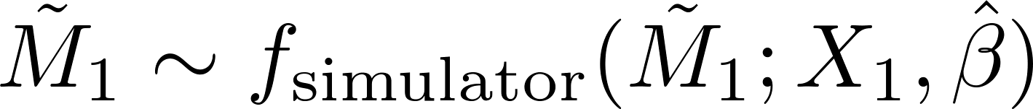
“Security by Simulation”
Consider the messages to party 1:
Depends on other’s private inputs
A distribution, since the protocol is randomized.
Suppose we construct a simulator:
Depends on what's available in ideal case

Slide 15
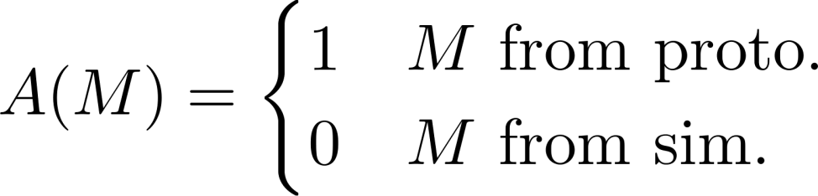
“Security by Simulation”
Consider the messages to party 1:
Depends on other’s private inputs
A distribution, since the protocol is randomized.
Suppose we construct a simulator:
Depends on what's available in ideal case
Try to decide which one a particular transcript is from:
A poly-time algorithm

Slide 16
“Security by Simulation”
Consider the messages to party 1:
Depends on other’s private inputs
A distribution, since the protocol is randomized.
Suppose we construct a simulator:
Depends on what's available in ideal case
Try to decide which one a particular transcript is from:
A poly-time algorithm
Can’t decide ➔ messages reveal no more than input/output.

Slide 17
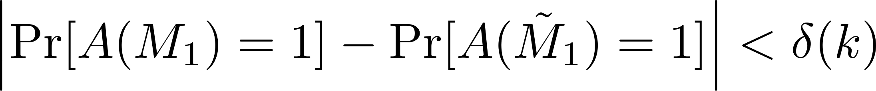
“Computational Indistinguishability”
Probability over transcripts and coin tosses of A
Negligible function of a security parameter k
Probability that decision is correct ≈ 0.5

Slide 18
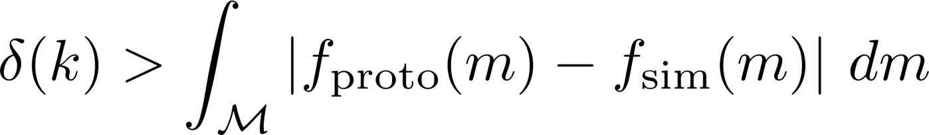
“Computational Indistinguishability”
Probability over transcripts and coin tosses of A
Negligible function of a security parameter k
Probability that decision is correct ≈ 0.5
A proper relaxation of statistical closeness:
Polynomially (in k) many secure sub-protocols may be composed.

Slide 19
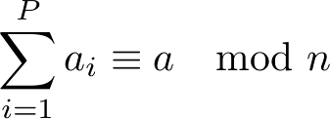

Basic Tools
Hide intermediate values as “random shares”:
Intermediate value
Uniformly distributed among all solutions.
One “share” per party
Sums may be computed locally

Slide 20
Basic Tools
Hide intermediate values as “random shares”:
Intermediate value
Uniformly distributed among all solutions.
One “share” per party
Use a sub-protocol for computing products of shares:
Uniformly distributed among all solutions.

Slide 21
Basic Tools
Hide intermediate values as “random shares”:
Intermediate value
Uniformly distributed among all solutions.
One “share” per party
Use a sub-protocol for computing products of shares:
Uniformly distributed among all solutions.
Random shares easy to simulate.
Sub protocols compose yielding secure protocol.

Slide 22


Basic Tools
Homomorphic encryption (e.g., Paillier ‘99)
Public key (like e.g., RSA)
Ciphertexts are indistinguishable.
(note, on ring mod n)
Allows math operations on encrypted values:
Public key
Security parameter
n ≈ 2^{k}
Allows construction of the “product” sub-protocol…

Slide 23



Secure Products (Integer)
Party 1 (has private key)
Party 2
Data held by party 1
Data held by party 2

Slide 24



Secure Products (Integer)
Party 1 (has private key)
Party 2
Encrypt values and send them.

Slide 25

Secure Products (Integer)
Party 1 (has private key)
Party 2
Draw r uniformly at random

Slide 26

Secure Products (Integer)
Party 1 (has private key)
Party 2
Decrypt, add local product

Slide 27
Secure Products (Integer)
Party 1 (has private key)
Party 2
Share of product
Share of product

Slide 28
Secure Products (Integer)
Party 1 (has private key)
Encrypted
Party 2
Uniform random variable
Share of product
Share of product

Slide 29

Yao’s Construction
In principle may now evaluate any circuit:
“xor,” “and” for binary a,b

Slide 30
Yao’s Construction
In principle may now evaluate any circuit:
“xor,” “and” for binary a,b
This is essentially a theoretical construction (nevertheless it is implemented in practice c.f., “fairplay”).
To accomplish even a floating point addition would take many encryptions.

Slide 31


Prior Work in Secure Multiparty Regression
Linear regression is sums and products (with tricks)
Matrix inversion
Inner products
Inner products
Chris Clifton et. al:
Inner product protocols for a weak definition of “secure.”
All reveal some info in addition to the estimate
Alan Karr et. al:
Compute , share them.
This work: A secure protocol which reveals only the output

Slide 32
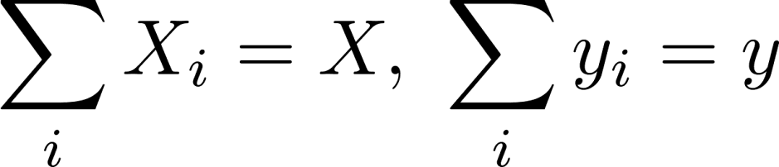
Input Data Setup
We suppose the data obey the following:
Subsumes all data partitioning schemes.
Leads to a general protocol for all situations.
Although, specialized protocols may be faster.
“X” data of party i
“Full” data

Slide 33
Our Protocol
Mostly sums and products.
Yao’s approach: very clean but inefficient.
Our approach: messy but fast(er)…
Fixed precision arithmetic.
Sadly: real numbers not integers

Slide 34

Secure Products (Real Approx)
Approximate reals with integers:
The real number
Integer representation

Slide 35

Secure Products (Real Approx)
Approximate reals with integers:
The real number
Integer representation
Using the previous method is wrong:
Need to divide off
“Decimal point” is pushed left

Slide 36
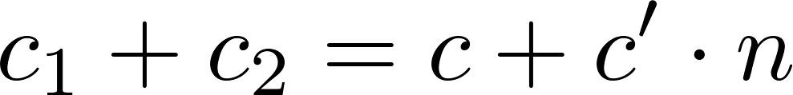
Secure Products (Real Approx)
Approximate reals with integers:
The real number
Integer representation
Using the previous method is wrong:
Can’t just correct shares locally:
Extra term due to “mod” in definition of RS

Slide 37
Secure Products (Real Approx)
Approximate reals with integers:
The real number
Integer representation
Using the previous method is wrong:
Can’t just correct shares locally:
Extra term due to “mod” in definition of RS
Proposed solution:
Assume bound on magnitude of product (mild assumption)
Restrict domain of noise to ensure that c’ = 1
“Correct” the results of locally dividing shares.
Shares remain C.I. from uniform distribution

Slide 38
Our Protocol
We can do sums and products on reals and everything composes nicely!
Matrix inversion is all we need

Slide 39

Inversion by Sums and Products
Computing the reciprocal of a
The zero of this function is x = a⁻¹

Slide 40

Inversion by Sums and Products
Computing the reciprocal of a
Use Newton’s method
f(x) = a⁻¹
Convergence is quadratic if 0 < x₀ < a⁻¹

Slide 41
Inversion by Sums and Products
Computing the reciprocal of a
Use Newton’s method
f(x) = a⁻¹
Convergence is quadratic if 0 < x₀ < a⁻¹
Inverting the matrix A
Number of iterations required depends on condition of A
Sums and products

Slide 42
Putting it Together
Step 1: Compute (shares of) X^{T}X, X^{T}y
Easy to parallelize by slicing X horizontally
Step 2: Compute shares of inverse
Use reciprocal of trace as starting point.
Step 3: Multiply shares of inverse with shares of X^{T}y
Step 4: Pool final shares and construct output.

Slide 43
CPS - Experimental Verification
Survey data with 50000 samples, 22 covariates.
Artificially split into 3 “parties” holding 10,8,4 covariates respectively (for all cases).
Using 1024 bit long keys.
Computation of X^{T}X, X^{T}y parallelized on 9 CPUs, takes roughly 1.5 days.
Matrix inversion takes 1 hour.

Slide 44
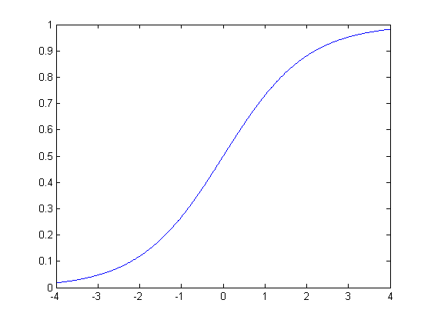
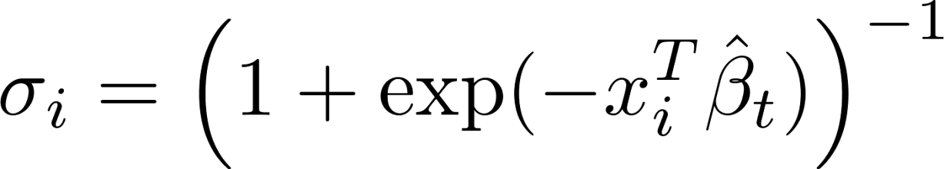
Logistic Regression
Iteratively Re-weighted Least Squares:
A non-linear thing to compute:
Repeated matrix inversion
Similar to linear regression….except:

Slide 45



Logistic Regression
Think of these as variables to update

Slide 46

Logistic Regression
Use Euler’s method to integrate the gradient
Multiple steps, per iteration
Introduces some error

Slide 47
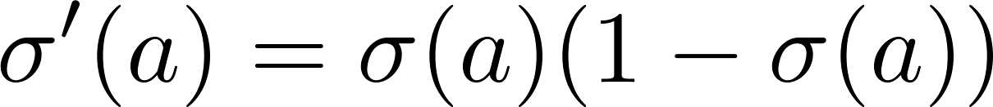
Logistic Regression
Use Euler’s method to integrate the gradient
Multiple steps, per iteration
Introduces some error
Gradient only involves sums and products.

Slide 48
Logistic Regression
Avoid repeated matrix inversion:
Invert only once (see e.g., Tom Minka)

Slide 49
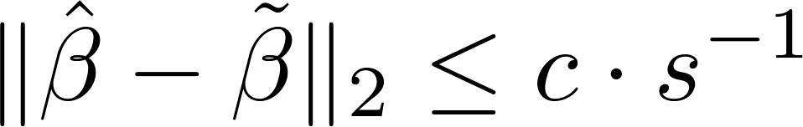
Logistic Regression
Avoid repeated matrix inversion:
Algorithm converges and has following property:
Invert only once (see e.g., Tom Minka)
Data dependent constant
Distance between optimizer of approximation and IRLS
Number of steps of Euler’s

Slide 50
Logistic Regression

Slide 51
Summary
Intro to cryptographic protocols.
Secure product protocol.
Our linear regression protocol:
Approximation of real math with integer math.
Reduction of matrix inverse to sums and products.
Our logistic regression protocol:
Approximation of logistic function by sums and products.

Slide 52
Ongoing Work
Record linkage
Implementation (R bindings?)
Regression variants
LARS, Lasso etc.
Privacy implications of regression coefficients.

Slide 53
Thanks

Slide 54


Privacy Implications
The (2 party) protocol computes the estimate:
At the end, party 1 may conclude that the data of party 2 falls into the set:
e.g., invertible implies total privacy invasion

Slide 55
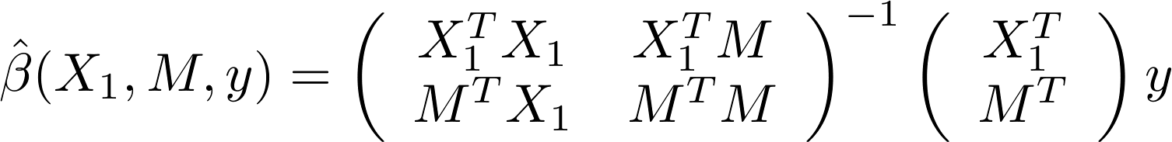
Privacy Implications (Vertical)
Consider the partitioning scheme:
The OLS estimate may be written as:

Slide 56
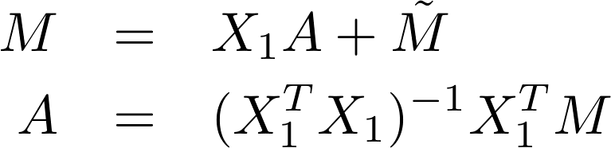
Privacy Implications (Vertical)
Consider the partitioning scheme:
The OLS estimate may be written as:
We may express M in terms of its projection onto X₁

Slide 57
Privacy Implications (Vertical)
Consider the partitioning scheme:
The OLS estimate may be written as:
We may express M in terms of its projection onto X₁
Grinding out the maths gives:

Slide 58
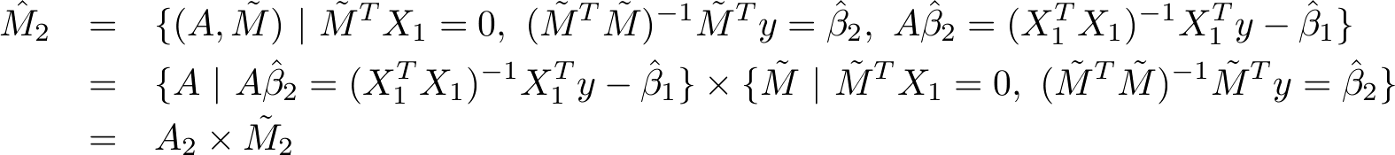
Privacy Implications (Vertical)
Express M₂ in terms of the new variables:
q = 1 means A is revealed

Slide 59
Ongoing Work
Logistic Regression (done but slow).
Lasso, LARs etc.
Record linkage (assumed here).
Imputation of missing data.
Secure computation of goodness-of-fit statistics.

Slide 60
Questions
For the technical details and code please see:
http://www.cs.cmu.edu/~rjhall/slr

Slide 61



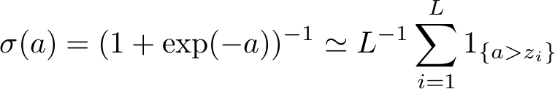
Logistic Regression (IRLS)
Newton-Raphson iterates:
Approximate sigmoid by the empirical CDF:
Secure computation of
“greater than” is well known.
Approximation error decreases with .

Slide 62
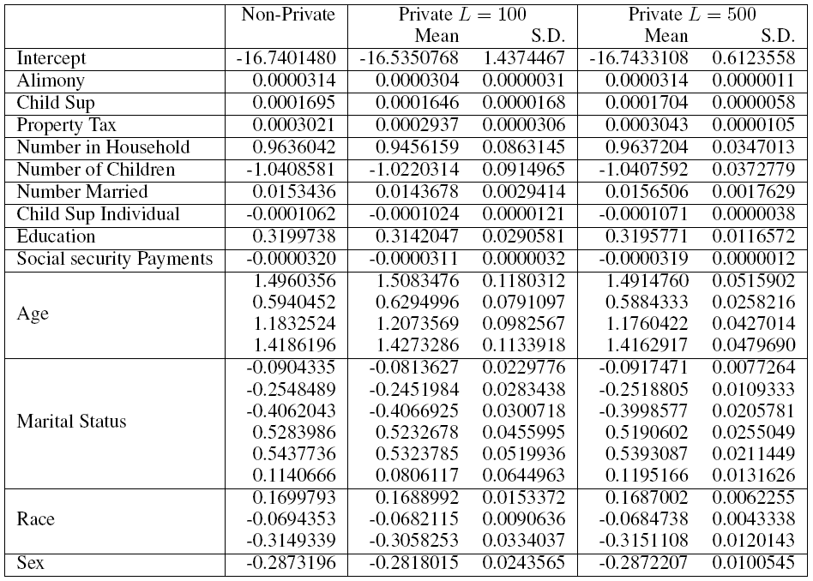
CPS - Experimental Verification
No. in Household | 0.96 | 0.95 | 0.09 | 0.96 | 0.03

Slide 63
CPS - Experimental Verification
Age(3) | 1.18 | 1.20 | 0.10 | 1.18 | 0.04

Slide 64

Alternative Approaches
Release “Sanitized” Data
Patient ID | Tobacco | Age | Weight | Heart Disease
0001 | ? | 36 | 170 | ?
0002 | N | 26 | 150 | ?
0003 | N | 45 | 165 | ?
… | … | … | … | …
Patient ID | Tobacco | Age | Weight | Heart Disease
0001 | ? | 36 | 170 | ?
0002 | N | 26 | 150 | ?
0003 | N | 45 | 165 | ?
… | … | … | … | …
Parties “sanitize” data
Patient ID | Tobacco | Age | Weight | Heart Disease
0001 | ? | 36 | 170 | ?
0002 | N | 26 | 150 | ?
0003 | N | 45 | 165 | ?
… | … | … | … | …
Patient ID | Tobacco | Age | Weight | Heart Disease
0001 | ? | 36 | 170 | ?
0002 | N | 26 | 150 | ?
0003 | N | 45 | 165 | ?
… | … | … | … | …
i.e., transform, the data into something they are willing to release

Slide 65

Alternative Approaches
Release “Sanitized” Data
Patient ID | Tobacco | Age | Weight | Heart Disease
0001 | ? | 36 | 170 | ?
0002 | N | 26 | 150 | ?
0003 | N | 45 | 165 | ?
… | … | … | … | …
Patient ID | Tobacco | Age | Weight | Heart Disease
0001 | ? | 36 | 170 | ?
0002 | N | 26 | 150 | ?
0003 | N | 45 | 165 | ?
… | … | … | … | …
Parties “sanitize” data
Patient ID | Tobacco | Age | Weight | Heart Disease
0001 | ? | 36 | 170 | ?
0002 | N | 26 | 150 | ?
0003 | N | 45 | 165 | ?
… | … | … | … | …
Patient ID | Tobacco | Age | Weight | Heart Disease
0001 | ? | 36 | 170 | ?
0002 | N | 26 | 150 | ?
0003 | N | 45 | 165 | ?
… | … | … | … | …
Data are pooled
Patient ID | Tobacco | Age | Weight | Heart Disease
0001 | ? | 36 | 170 | ?
0002 | N | 26 | 150 | ?
0003 | N | 45 | 165 | ?
… | … | … | … | …
Sanitization scheme may affect estimator

Slide 66
Alternative Approaches
Release “Sanitized” Data
“Secure Multiparty Computation”
Patient ID | Tobacco | Age | Weight | Heart Disease
0001 | ? | 36 | 170 | ?
0002 | N | 26 | 150 | ?
0003 | N | 45 | 165 | ?
… | … | … | … | …
Patient ID | Tobacco | Age | Weight | Heart Disease
0001 | ? | 36 | 170 | ?
0002 | N | 26 | 150 | ?
0003 | N | 45 | 165 | ?
… | … | … | … | …
Parties “sanitize” data
Distributed computation that ensures privacy
?
Patient ID | Tobacco | Age | Weight | Heart Disease
0001 | ? | 36 | 170 | ?
0002 | N | 26 | 150 | ?
0003 | N | 45 | 165 | ?
… | … | … | … | …
Patient ID | Tobacco | Age | Weight | Heart Disease
0001 | ? | 36 | 170 | ?
0002 | N | 26 | 150 | ?
0003 | N | 45 | 165 | ?
… | … | … | … | …
Data are pooled
Patient ID | Tobacco | Age | Weight | Heart Disease
0001 | ? | 36 | 170 | ?
0002 | N | 26 | 150 | ?
0003 | N | 45 | 165 | ?
… | … | … | … | …
Sanitization scheme may affect estimator
Output the correct result

Slide 67
Yao’s Protocol
Theoretically can now compute anything!
How:
Compose sums and products in mod 2.
Corresponds to “xor” and “and.”
Sufficient to compute any circuit.
Theoretically, we’re done already … but

Slide 68
Yao’s Protocol
Theoretically can now compute anything!
How:
Compose sums and products in mod 2.
Corresponds to “xor” and “and.”
Sufficient to compute any circuit.
Theoretically, we’re done already … but
Leads to very slow protocols!

